Slide 1
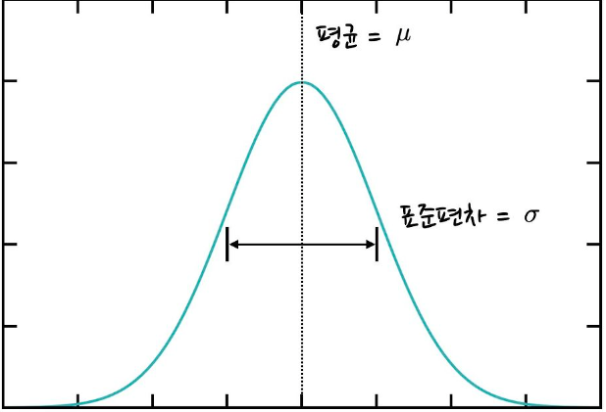




Speed Control
가우스 함수 (정규 분포) 이용
$f\left(x\right)=ae^{−\frac{{(x−b)}^{2}}{c^{2}}}$
F(x)
delay
delay_max
$$target angle$$
delay_min
$$θ$$
$$θ$$
중심

Slide 2
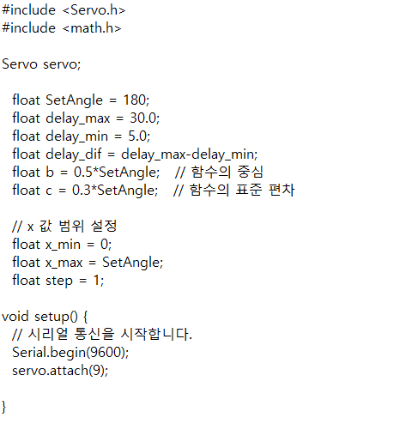
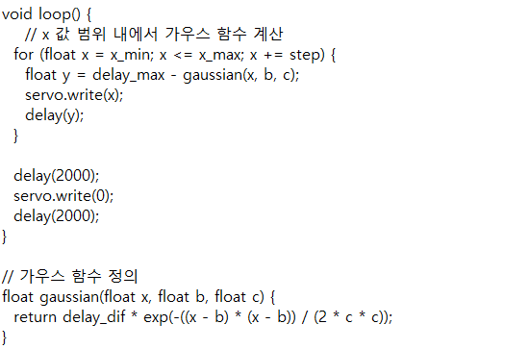
Test Code

Slide 3
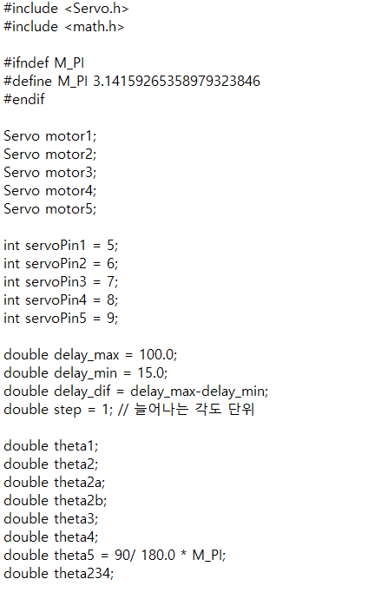
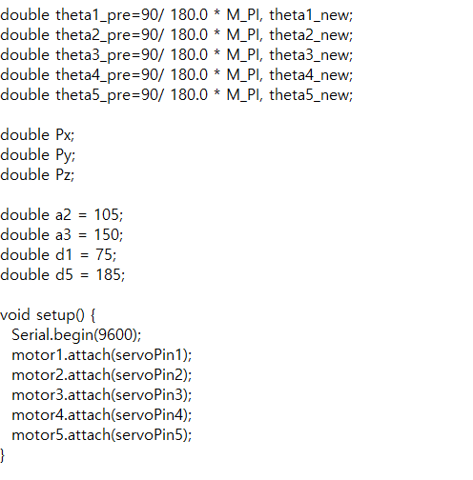
Fixed Code

Slide 4
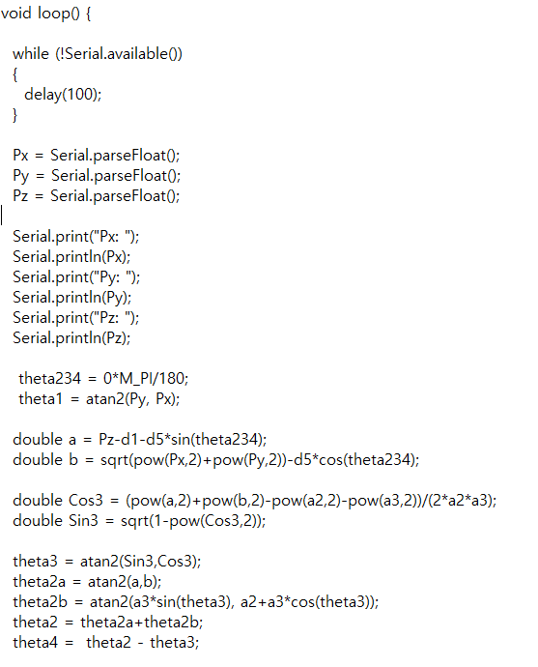
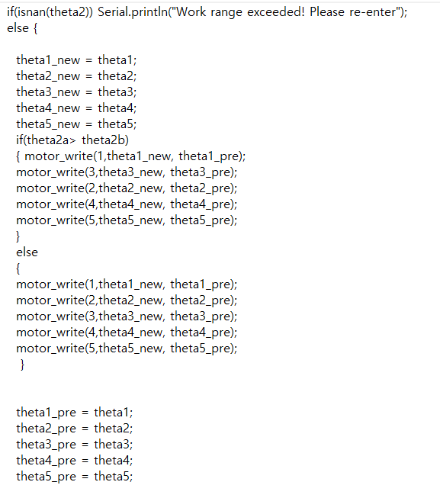
Fixed Code

Slide 5
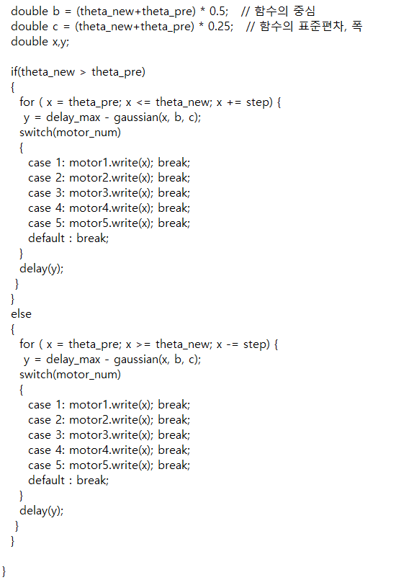
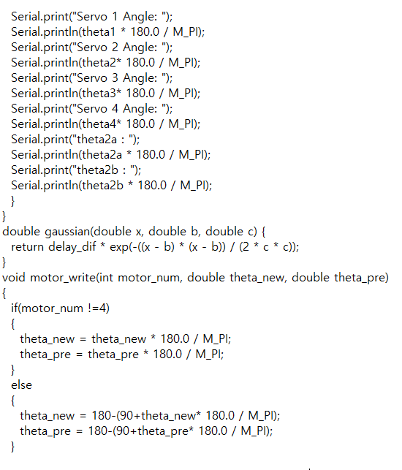
Fixed Code

Slide 6






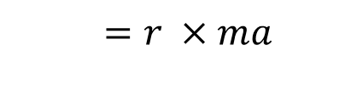



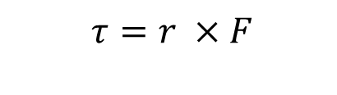




Motor Torque
$$m_{a}$$
$$l_{3}$$
$$m_{3}$$
$$l_{2}$$
$$τ_{3}$$
$$τ_{2}$$
$$m_{2}$$
$$τ=r ×F$$
$$l_{1}$$
$$m_{1}$$
$$=r ×ma$$
$$τ_{1}$$
$$τ_{3}= {(m}_{3}+m_{a}) g l_{3}$$
$τ_{2}= {(m}_{3}+m_{2}+m_{a}) g {(l}_{3}$+$l_{2})$
$τ_{1}= {(m}_{3}+m_{2}{+m}_{1}+m_{a}) g {(l}_{3}$+$l_{2}+l_{1})$

